Slide 1
Lecture “8” Manage Project Team
Inputs
Tools & Techniques
Outputs

Slide 2
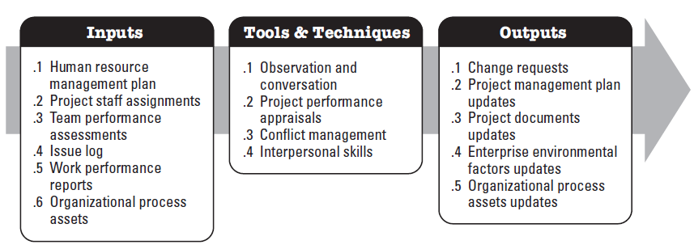
Manage Project Team
Manage Project Team is a process of tracking team member performance, providing feedback, resolving issues and managing team changes to optimize project performance.
BENEFITS
Team Behavior
Manages Conflict
Resolve Issues
Appraise Team Member Performance

Slide 3
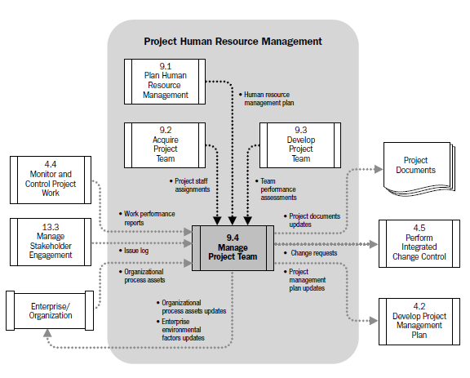
Manage Project Team
Data Flow Diagram

Slide 4
Critical Factors
Communication
Conflict Management
Negotiation
Leadership

Slide 5
Managing Versus Leading a Project
Managing—coping with complexity
Formulate plans and objectives
Monitor results
Take corrective action
Expedite activities
Solve technical problems
Serve as peacemaker
Make tradeoffs among time, costs, and project scope
Leading—coping with change
Recognize the need to change to keep the project on track
Initiate change
Provide direction and motivation
Innovate and adapt as necessary
Integrate assigned resources

Slide 6
Human Resource Management Plan
A part of the Project Management Plan, provides guidance on how project human resources should be defined, staffed and eventually released.
The human resource management plan and any subsequent revisions are also inputs into the ‘Develop Project Management Plan Process’
Roles & Responsibilities
Staffing Management Plan
Project Organization Charts
Staff Release Plan
Training Needs
Recognition & Awards

Slide 7
Project Staff Assignments
The project is staffed when appropriate people have been assigned to the team
The documentation of these assignments can include;
Project team directory.
Memos to team members.
Names inserted into other parts of the project management plan such as project organization charts and schedules.

Slide 8
Team Performance Assessments
Formal and Informal assessments of Project Team’s Effectiveness
Should be determined by all parties
Technical Success
Agreed upon Project Objectives
Meeting Quality Levels
Performance on Project Schedule
Performance on Budget

Slide 9
Team Performance Assessments
Improvements in skills that allow individuals to perform assignments more effectively.
Improvements in competencies that help the team perform better as a team.
Reduced turnover Rate
Increased team cohesiveness where team members share information and experiences openly and help each other to improve the overall project performance.
Specific Training
Coaching
Mentoring
Assistance
Required Resources

Slide 10
Issue Log and Work Performance Reports
Issues arise in the course of managing the project team. An issue log can be used to document and monitor who is responsible for resolving specific issues by a target date
Work performance reports provide documentation about the current project status compared to project forecasts. Performance areas that can help with project team management include results from;
Schedule Control
Cost Control
Quality Control
Scope Validation
The information from performance reports and related forecasts assists in determining future human resource requirements, recognition and rewards and updates in the staffing management plan

Slide 11
Work Performance Reports
Examples of Work Performance Reports include;
Status Reports
Memos
Justifications
Information notes
Recommendations
Updates
Work Performance Reports are the physical or electronic representation of work performance information compiled in project documents, intended to generate decisions, actions or awareness. Specific work performance metrics may be defined at the start of the project and included in the normal work performance reports provided to key stakeholders.

Slide 12
Tools & Techniques
Observation & Conversation
Project Performance Appraisals
Conflict Management
Interpersonal Skills

Slide 13
Project Performance Appraisals
Objectives for conducting performance appraisals during the course of a project can include;
Clarification of roles and responsibilities
Constructive feedback to team members
Discovery of unknown or unresolved issues
Development of individual training plans
Establishments of specific goals for future time periods
The need for formal or informal project performance appraisals depends on the length of the project, complexity of the project, organizational policy, labor contract requirements and the amount and quality of regular communication.

Slide 14
Conflict Management
Conflict Management
Problem Solving Approach
Use Patience & Respect
Negotiation
Mediation
Divergence of opinion lead to conflicts

Slide 15
Conflict Management
Sources of Conflict
Value Conflict
Data Conflict
Interest Conflict
Structural Conflict

Slide 16
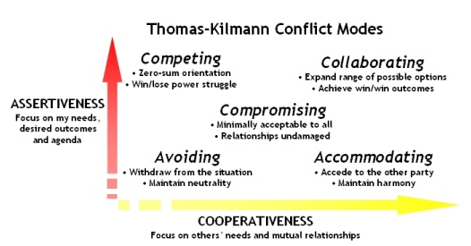
Conflict Management
It is used when outcome is more important than relationship, e.g., in emergencies. This also involves assertiveness but not cooperation.
Can mean running away but evasion or delay can be appropriate and constructive. This approach can be useful in highly emotional situations where time is needed to gain perspective.
Both sides agreeing to make small or superficial concessions. Both parties make concession and bargaining to and reach a settlement to which both agree.
Cooperation wherein one side agrees to other's wants. Usually occurs when the outcome of the situation is very important to one person but less so to the other.
Meeting underlying needs of both parties. It allows assertiveness and cooperation in the search for a solution that meets the needs of all.

Slide 17
Conflict Management
Smooth/ Accommodate
Compromise/ Reconcile
Force/ Direct
Collaborate/ Problem Solve
Withdraw / Avoid
Retreating from an actual or potential conflict situation; postponing the issue to be better prepared or to be resolved by others.
Emphasizing areas of agreement rather than areas of difference; conceding one’s position to the needs of others to maintain harmony and relationships.
Searching for solutions that bring some degree of satisfaction to all parties in order to temporarily or partially resolve the conflict.
Pushing one’s viewpoint at the expense of others; offering only win-lose situations, usually enforced through a power position to resolve an emergency.
Incorporating multiple viewpoints and insights from differing perspectives; requires a cooperative attitude and open dialogue that typically leads to consensus and commitment.

Slide 18
Interpersonal Skills
Interpersonal Skills
Leadership
Influencing Power
Effective Decisions Making
- Autocratic
Bureaucratic
Consensus Building
Laissez Faire
- Focus on Goals
Decision Making Process
Environmental Factors
Available Information
Team Creativity
Risk Management
Persuasiveness
Active Listening
Awareness of Situation
Critical Information
Mutual Trust

Slide 19
Outputs
Outputs
Change Requests
Project Management Plan Updates
Project Documents Updates
Enterprise Environmental Factor Updates
Organizational Process Assets Updates

Slide 20
Change Requests
Staffing changes whether by choice or by uncontrollable events can affect the rest of the project management plan.
When staffing issues disrupt the project team from adhering to the project management plan such as causing the schedule to be extended or the budget to be exceeded, a change request can be processed through the Perform Integrated Change Control Process.
Preventive actions have been developed to reduce the probability and /or impact of problems before they occur.
Moving people to different Assignments
Outsourcing some of the work
Replacing team members who leave

Slide 21
END OF SESSION

